Slide 1

Alan Safran, President and
Barbara Algarin, Executive Director
Mexico City
June 21, 2016

Slide 2
History of High Dosage Tutoring
2004
Launch
Match Education (Boston, MA)
2010
Test
Houston (TX)
Roland Fryer (Harvard Ed Labs)
Validate
Scale
2014
2011-2014
SAGA Innovations
Lawrence (MA)
Stamford (CT)
Chicago (IL)

Slide 3
Our theory of action: The facts present a problem
Students arrive at High School 2,3,4 or many more years behind grade level.
High school teachers are trying to teach grade level math, but kids can’t add 3 plus -2.
Class size is too large to allow teachers to differentiate instruction to catch kids up. Most schools are too big, and most teachers are too busy, to notice on a daily basis what issues are holding kids back.
But if kids don’t pass first year HS math course in the US, 5 out of 6 will NOT graduate. There will be an 83% chance of dropout.

Slide 4
Our theory of action: A solution
We need a school-based strategy to help kids pass their entry level math class in High School.
We need this strategy to boost kids’ self-confidence and self-efficacy, and their problem-solving skills, so that the math intervention carries over to other subjects.
We need parents to be partners.
We need to focus on connectedness, kids having strong relationships with adults, as a draw to bring kids to school.

Slide 5
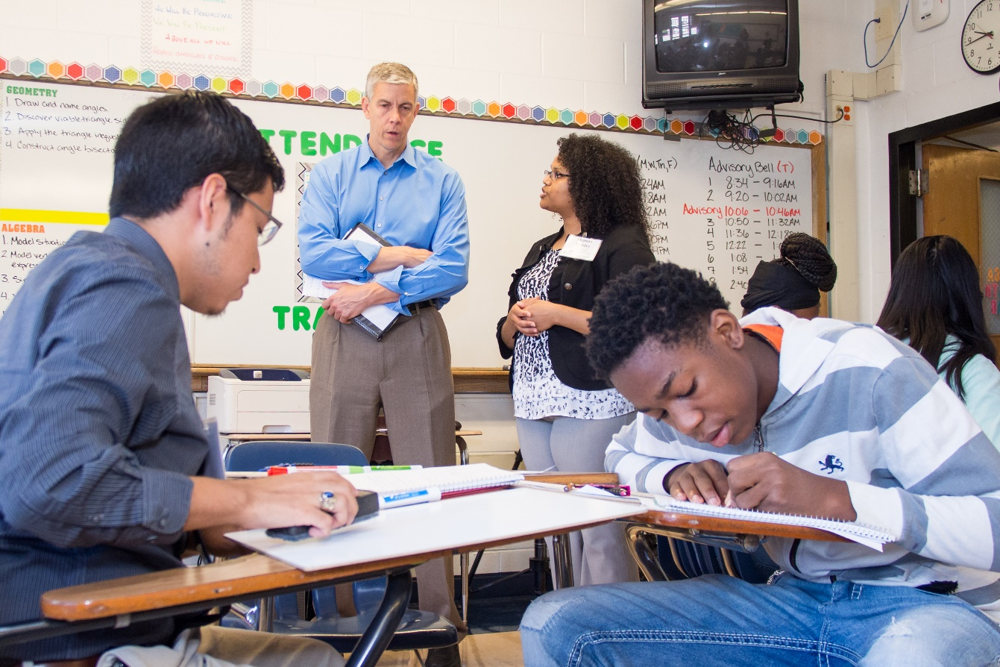
Key Structural Components
1
Embedded into the school day as a scheduled class period
2
Small groups (1 tutor to 2 students)
3
Consistent parings throughout the year
4
Frequent parent communication

Slide 6
Why use high dosage tutoring?
Reason 1
Accelerates academic progress
Reason 2
Provides role models for college success
Reason 3
Builds reliable channel for regular parent communication
Reason 4
Supplements classroom instruction (teacher friendly)
Reason 5
Generates talent pipeline

Slide 7


Research & Evaluation
Houston, TX
Chicago, IL
2010
2013-Present
3000 6th & 9th Graders
9th and 10th Graders
600 (Y1), 1000 (Y2)
2-4 years of math growth in one year
Reduce achievement gap by 1/3 in one year
Not an RCT
RCT
Two major scientific studies done on this work

Slide 8
Houston Results (1)
Ninth Grade Math 2010-2011
0.2
0
Apollo
Std_math
-0.2
Other HISD Schools Comparison Schools
-0.4
-0.6
2008
2009
2010
2011
10

Slide 9
Houston Results (2)
Sixth Grade Math Scores 2010-2011
0.2
0
Apollo
-0.2
std_math
Other HISD Schools Comparison
Schools
-0.4
-0.6
2008
2009
2010
2011

Slide 10
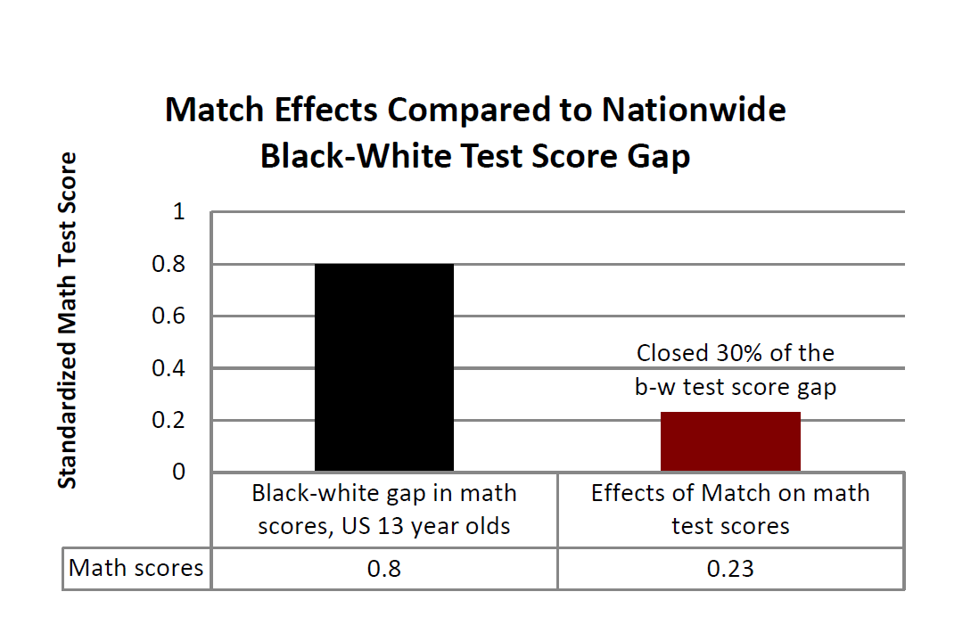
Chicago Results (1)

Slide 11
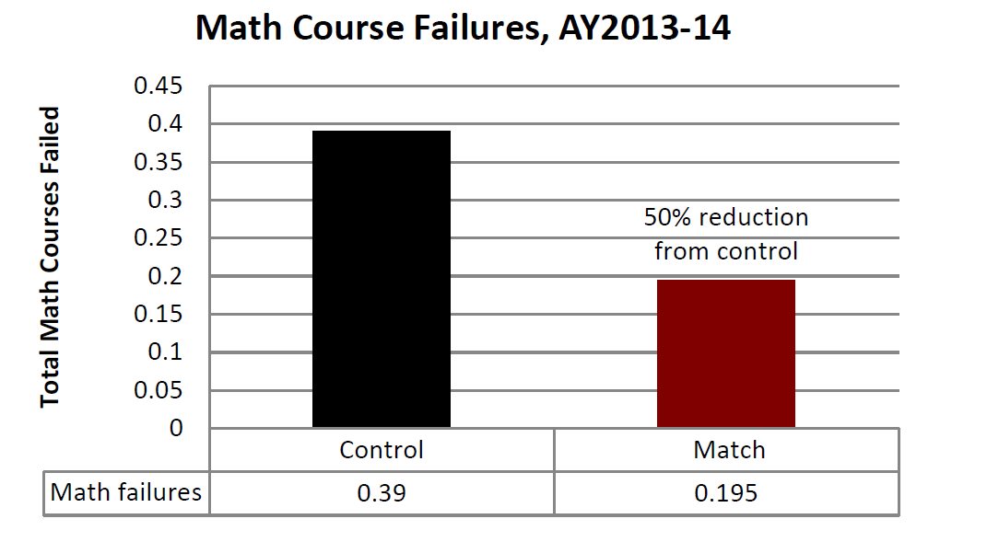
Chicago Results (2)

Slide 12
Chicago Results (3)

Slide 13
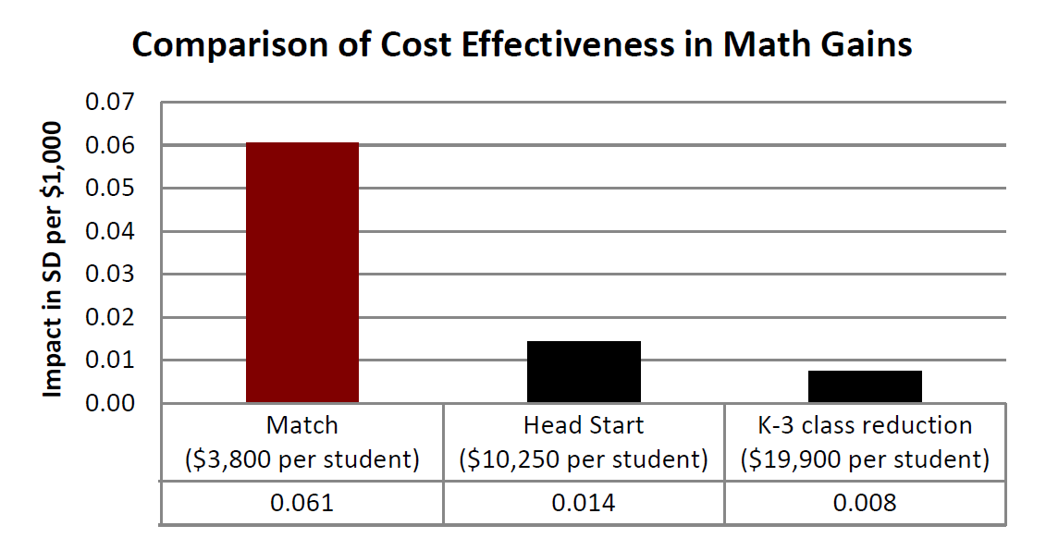
Chicago Results (4)

Slide 14
Other Important Results: Match Schools
Impact of Tutoring on Math Results on MCAS* (Grade 10)
100
90
80
70
60
50
40
30
20
10
0
% proficient or advanced
Match Boston
2004
2005
2006
2007
2008
2009 2010
2011
2012
2013
Match Corps program starts
*MCAS is the Massachusetts state graduation test administered in grade 10

Slide 15

Other Important Results: Lawrence, MA
Two lowest performing high schools vaulted to the top 7% of high school students in the state, in terms of the rate of growth in student achievement
80
70
60
50
40
30
20
10
0
Math SGP Score
Tutor
intervention
2009
2010
2011
2012
2013
Greatest turnaround in growth in math in MA state history

Slide 16
How we do this (U.S.)
Program Design
Recruitment and Selection
Training
Program Management
Curriculum Design
Data and Assessments

Slide 17
Training: Sample Topics
Categories | Example activities
Foundational sessions | The SAGA Tutorial Model
 | Building Tutor Culture and Expectations
 | Overview of Training
 | Tutorial Videos
Tutorial structure and practice | Observing for Effective Tutorial Techniques:
 | Check for Understanding
 | No Opt Out/100%
 | Positive Framing/Precise Praise
 | Ratio/Break it Down
 | Stretch It/Right is Right
 | Strong Voice/Tone
 | What to Do
Coaching practice | Observation Calibration
 | Coaching Strategies
 | Extensive Practice /Role Play Sessions
Curriculum | Class Support Component
 | Curriculum Overview (General, Scope, Calendar)
 | Adapting Tutorial to Students' Needs
 | Tutorial Overview
Tutorial Toolbox | Cultural Awareness
 | De-escalation
 | Intervention Techniques
 | Motivating Reluctant Students
 | Parent Communication
 | Special Ed 101
 | Supporting Students' Emotional and Behavioral Needs
Team Building | Commonalities
TRAINING AREAS
Tutorial structure and practice
Coaching practice
Tutorial toolbox
Team building
Curriculum
Foundational sessions

Slide 18
How we do this (International)
1
Onsite and remote consulting
2
Training
3
Sharing documents & materials
Providing consulting support to the University of Amsterdam and a nonprofit organization in Rotterdam

Slide 19
Costs
In the USA, this intervention costs $2750 to $3600 per pupil per year.
With the cost of living much less in Mexico and Latin America, we believe these figures can be reduced by 40 to 50%.
We are happy to discuss options with any interested nation.

Slide 20

Questions?

Slide 21
Contacts
Alan Safran, President, asafran@sagainnovations.org
Barbara Algarin, Executive Director, balgarin@sagainnovations.org

