Slide 1


Preventing dropout and youth violence: Lessons and observations from Chicago
Julia Quinn, Research Manager
John Wolf, Senior Project Manager

Slide 2
Violence Worldwide
In 2012, the United Nations Office of Drugs & Crime estimated that 437,000 people worldwide (6.2 per 100,000 pop.) died of intentional violent injuries.¹
Of these deaths:
4.7 per 100,000 pop. occurred in the United States.¹
18.41 per 100,000 pop. occurred in Chicago.²
25.2 per 100,000 pop. occurred in Brazil.¹
41.2 per 100,000 pop. occurred in El Salvador.¹
3.5 per 100,000 pop. occurred in India.¹
0.7 per 100,000 pop. occurred in Sweden.¹
¹United Nations Office on Drugs and Crime (2013) Intentional homicide, count and rate per 100,000 population (2000 - 2011)
²Federal Bureau of Investigation (2013) Crime in the United States 2012.

Slide 3
Disproportionate Effect on Youth
Crime disproportionately affects youth, both in terms of crimes committed and as victims of violent crimes

Slide 4
Gun Homicide in the U.S.: Rates per 100,000 (males, ages 15-24)
High-Income Countries
0.4
Whites
12.74
Latinos
Blacks
10
Source: Centers for Disease Control and Prevention WISQARS, National Violent Death Reporting System (NVDRS)

Slide 5
Gun Homicide in the U.S.: Rates per 100,000 (males, ages 15-24)
15.0 Latinos
20
Source: Centers for Disease Control and Prevention WISQARS, National Violent Death Reporting System (NVDRS)

Slide 6
Gun Homicide in the U.S.: Rates per 100,000 (males, ages 15-24)
30
Source: Centers for Disease Control and Prevention WISQARS, National Violent Death Reporting System (NVDRS)

Slide 7
Gun Homicide in the U.S.: Rates per 100,000 (males, ages 15-24)
40
Source: Centers for Disease Control and Prevention WISQARS, National Violent Death Reporting System (NVDRS)

Slide 8
Gun Homicide in the U.S.: Rates per 100,000 (males, ages 15-24)
High-Income Countries
Whites
Latinos
53.2
Blacks
50
Source: Centers for Disease Control and Prevention WISQARS, National Violent Death Reporting System (NVDRS)

Slide 9
Mortality Rate by Cause of Death, 1950-2013

Slide 10
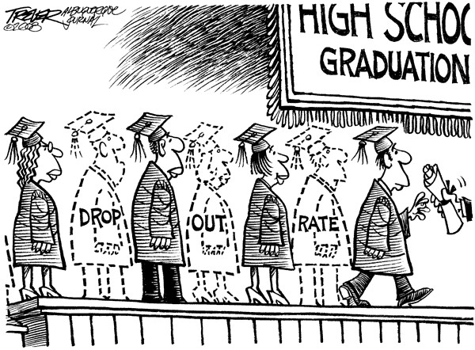
50%

Slide 11

Urban Labs partners with cities to identify and rigorously evaluate the policies and programs with the greatest potential to generate large-scale social change across five key dimensions of urban life:
EDUCATION
HEALTH
ENERGY &
ENVIRONMENT
CRIME
POVERTY

Slide 12
WE WORK WITH CITIES TO:
IDENTIFY
promising solutions to urban challenges
TEST
the most promising urban policies and programs
SCALE UP
the most effective and cost-efficient policies and programs

Slide 13
WE WORK WITH CITIES TO:
IDENTIFY
promising solutions to urban challenges
TEST
the most promising urban policies and programs
SCALE UP
the most effective and cost-efficient policies and programs

Slide 14
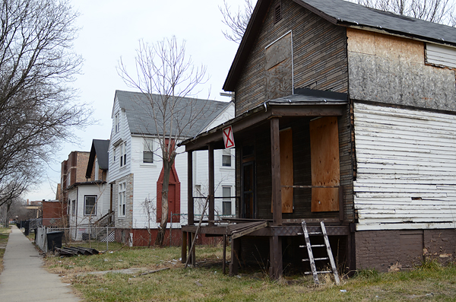

Slide 15

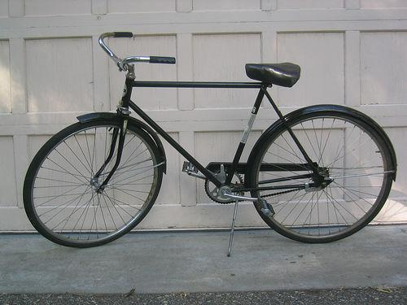

Slide 16
INNOVATION CHALLENGE: A KEY MECHANISM FOR DISCOVERY
Policymakers, practitioners, and community members propose promising solutions
to urban challenges
Urban Labs researchers and other experts review and select ideas
Urban Labs rigorously evaluates and helps scale the most cost-efficient and effective programs and policies, in Chicago and across the globe

Slide 17



Slide 18
WE WORK WITH CITIES TO:
IDENTIFY
promising solutions to urban challenges
TEST
the most promising urban policies and programs
SCALE UP
the most effective and cost-efficient policies and programs

Slide 19
THE IMPORTANCE OF RESEARCH: MEASURING OUTCOMES
ELIGIBLE STUDENTS
RANDOMLY DIVIDED
INTO TWO GROUPS,
SIMILAR TO LOTTERY/COIN FLIP
POST-INTERVENTION,
OUTCOMES ARE MEASURED
FOR BOTH GROUPS
BEHAVIOR CHANGE
NO BEHAVIOR CHANGE

Slide 20
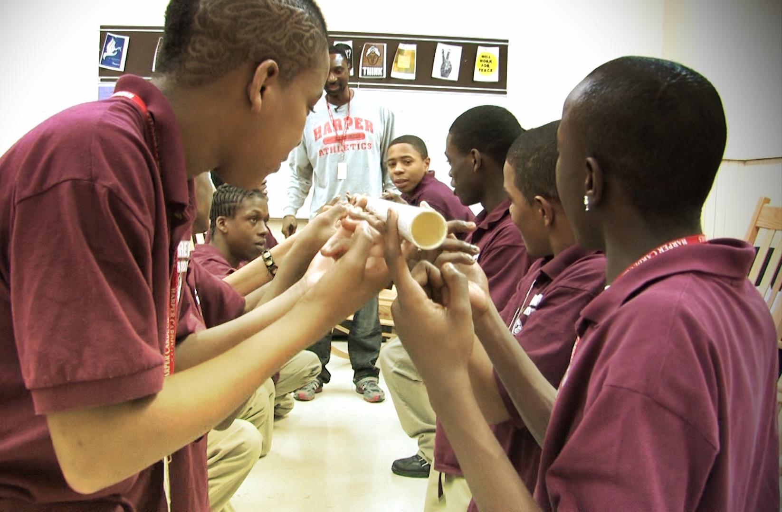

-45%
Study 1: 2009-10
Becoming a Man (Youth Guidance)
27 week, 1 hour / week, 10-15 students / group

Slide 21

Too difficult and costly to improve academic outcomes?

Slide 22
For all a and b,
6a²b³ – 3a²b is equivalent to which of the expressions?
If 3x – 10 = 24, then x = ?

Slide 23
8 + 14 – 7 7 x 4

Slide 24



Slide 25
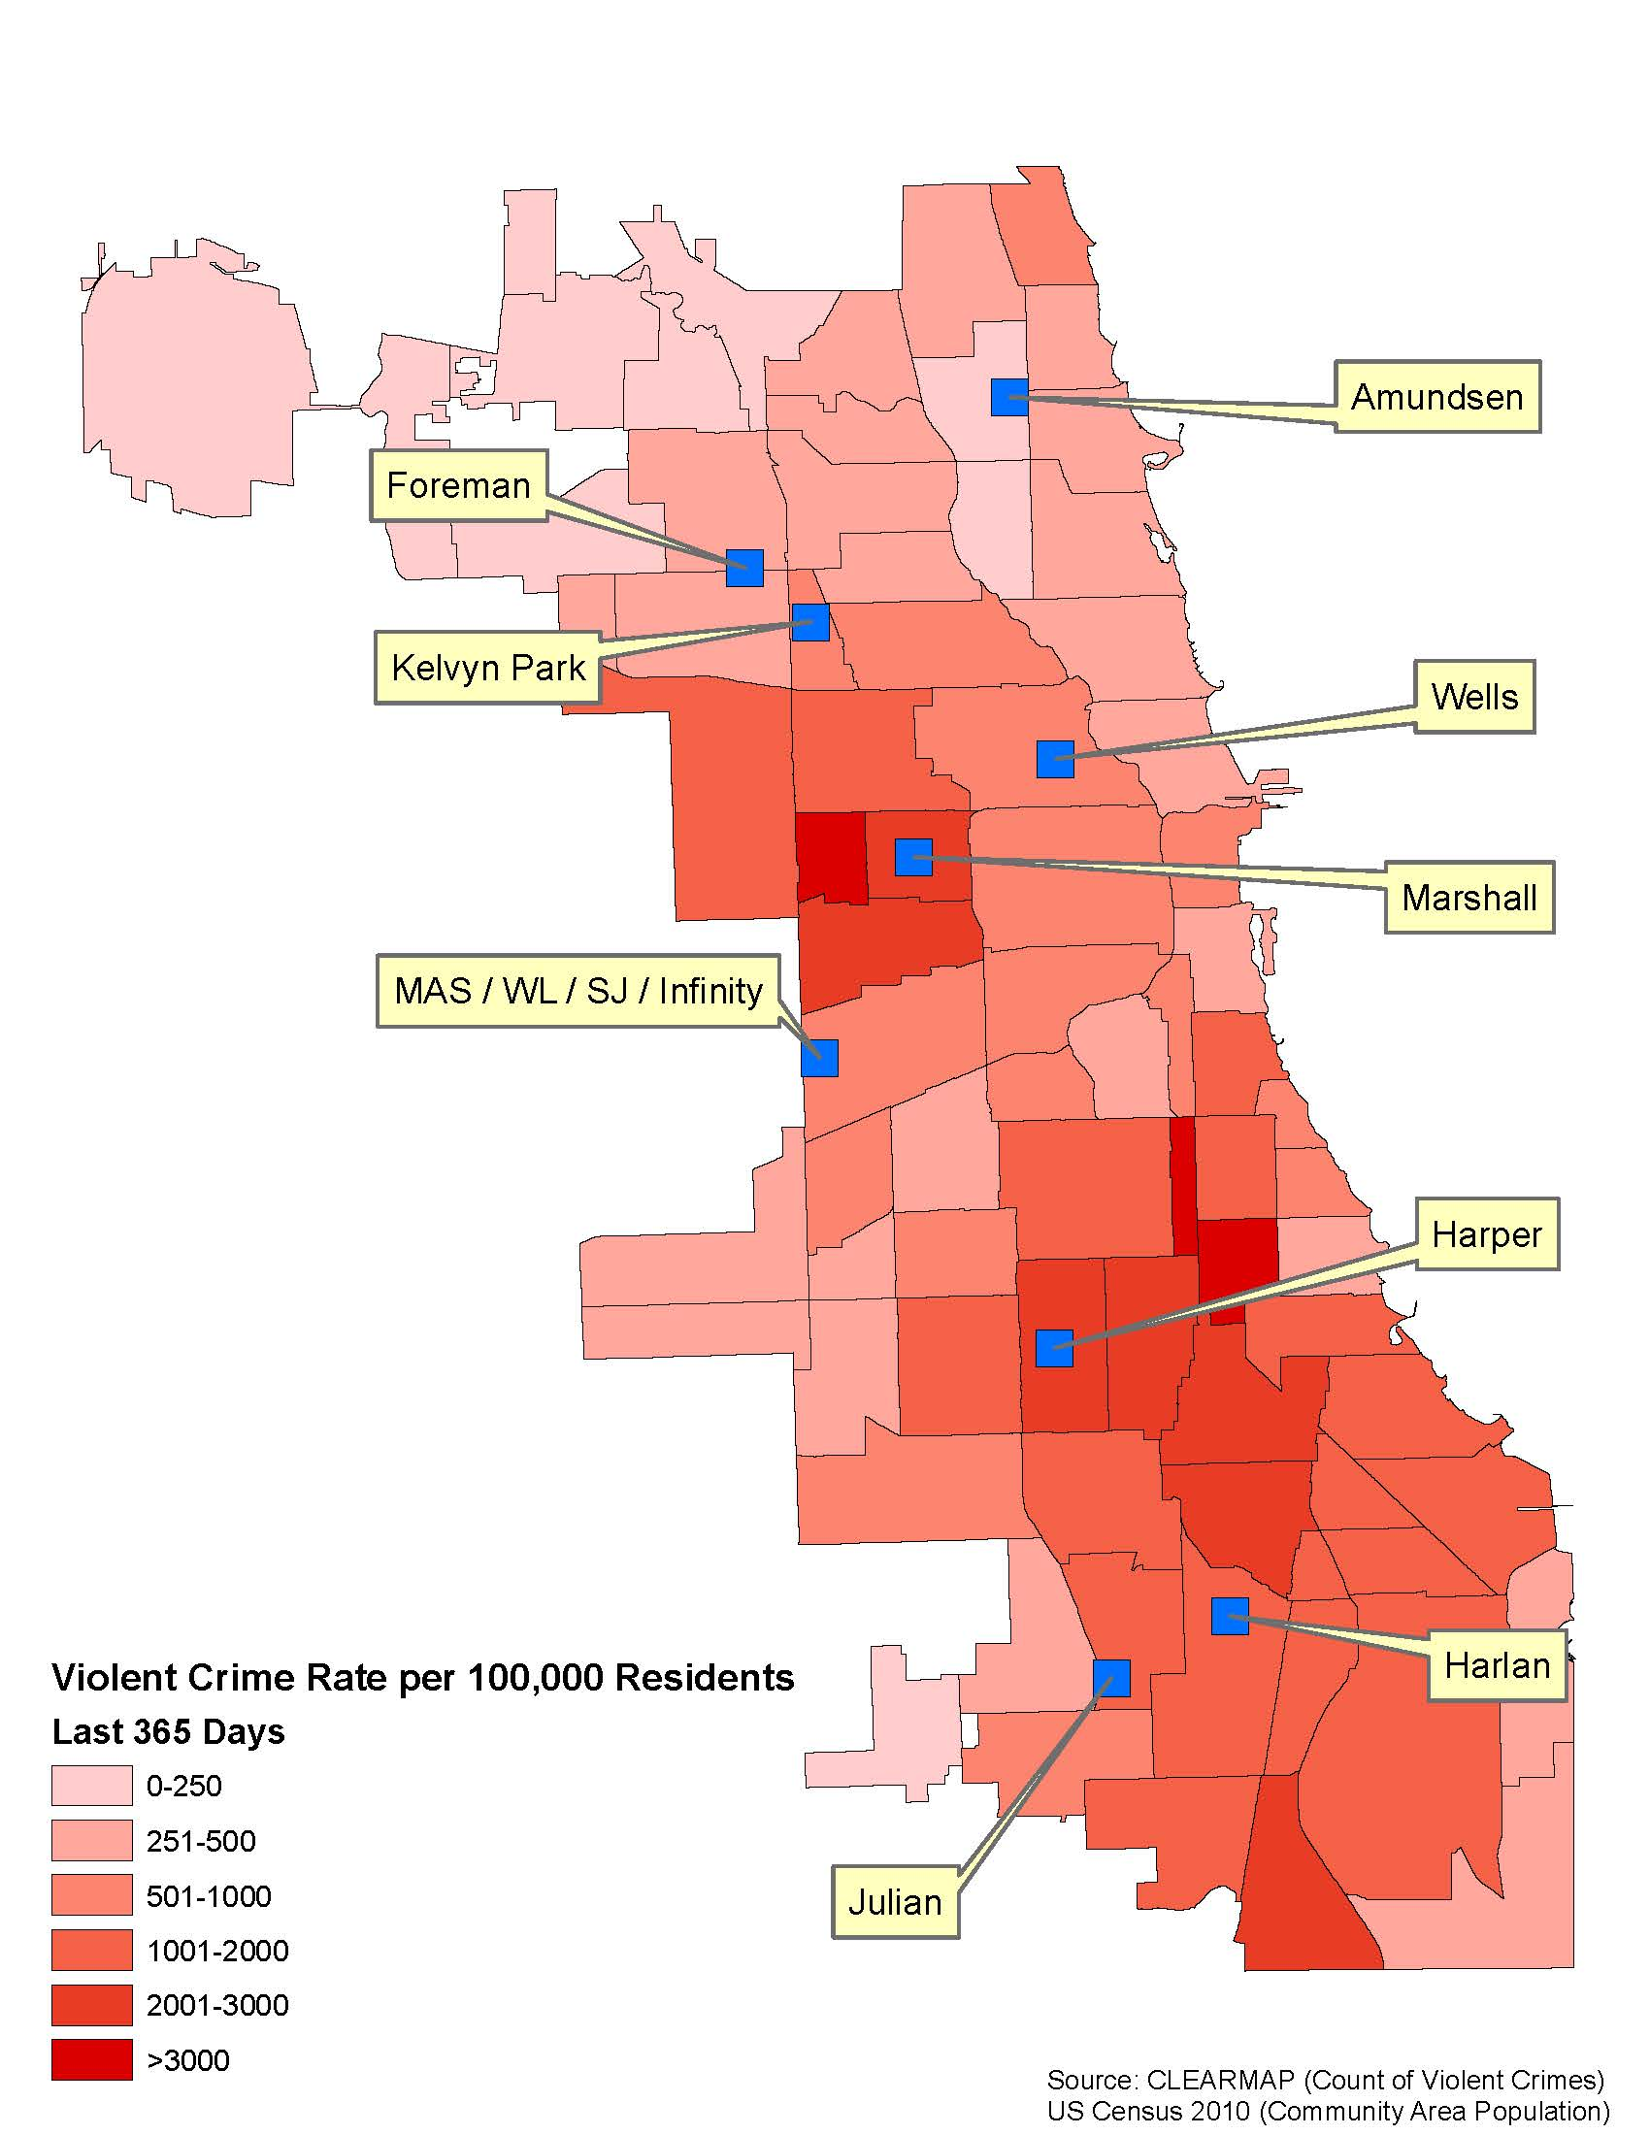
2,718 9th and 10th graders randomly assigned to program vs. control

Slide 26
Gain in math scores by 30% of B-W gap (equal to 1 to 2 years of extra math learning, in 1 year)

Slide 27

-50%
Study 2: 2013-15
Becoming a Man (Youth Guidance)
2,064 male 9th and 10th graders, 9 CPS high schools

Slide 28

Now that it’s 2016…
Study 1: 2009-10
Long-term follow-up data

Slide 29
18%

Slide 30
$$$$$
$$$$$
$$$$$
$$$$$
$$$$$
$$$$$
$
Cost
Benefit

Slide 31
“20 percent of our residents are criminals, they just need to be locked up. But the other 80 percent, I always tell them – if I could give them back just ten minutes of their lives, most of them wouldn’t be here.”

Slide 32


Slide 33
WE WORK WITH CITIES TO:
IDENTIFY
promising solutions to urban challenges
TEST
the most promising urban policies and programs
SCALE UP
the most effective and cost-efficient policies and programs

Slide 34
TYPICAL APPROACH TO SCALING IN SOCIAL SCIENCE
FIND OR DESIGN
PROMISING PROGRAM
STUDY IT AT SMALL/MODERATE
SCALE
DISSEMINATE
FINDINGS
HOPE

Slide 35
“Nearly every problem has been solved by someone, somewhere...we can’t seem to replicate [those solutions] anywhere else.”
President Bill Clinton

Slide 36


Slide 37


Slide 38
HOW URBAN LABS THINKS ABOUT SCALING
It’s the inputs that matter
We should test impact at scale before going to scale
Identifying the specific recipe for scalability is key
Success depends on strong relationships with policymakers

Slide 39

It takes a city… - Government and agency partners - Non-profit partners - Access to data - Funding

Slide 40
Implementing RCTs in schools… - Partnering with schools - Leveraging (or developing) an administrative data infrastructure - Accessing data - Fidelity to randomization

Slide 41
No shortage of innovation → it’s evidence that is in short supply
Best projects are defined jointly by policymakers and researchers
Effective social programs can have dramatic impact at scale

Slide 42

Geography and context are key,
but sharing lessons with each other
may help policymakers worldwide
design effective and cost-effective
approaches to create safer cities.

Slide 43
Helping cities make smarter bets to improve human lives at scale

