Slide 2
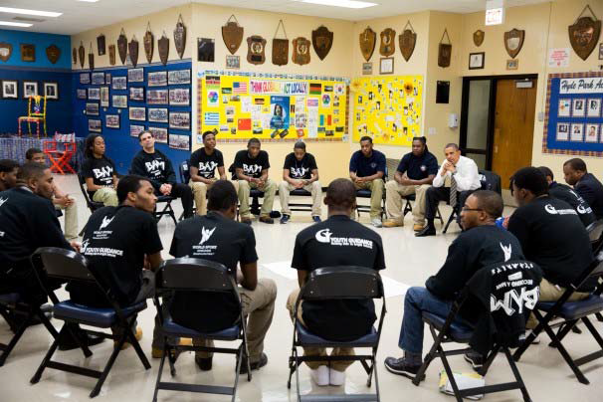
Mission & Expertise
Mission: Youth Guidance creates and implements school-based programs that enable at-risk children to overcome obstacles, focus on their education and, ultimately, to succeed in school and in life.
Youth Guidance programs serve more than 8,000 youth each year in approximately 80 schools through:
Counseling and Prevention:
  Becoming a Man (B.A.M.)
  Working on Womanhood (W.O.W.)
Youth Workforce Development
Community and After-School
Notes:
Michelle

Slide 3

Target Population
B.A.M. has served young men at 52 schools this year who:
Are actively enrolled in school
Are in grades 7-12
Reside in high risk environments
Are economically disadvantaged, meeting at least one of the federal guidelines defining poverty
Demonstrate commitment to pursuing personal growth by attending four group sessions within the first two months of entering the program
15-16 B.A.M. student population:
2,759 students were served by 47 B.A.M. counselors at 52 schools
67% African American
30% Latino
3% White, Asian, Multiracial, or Other ethnicity
95% eligible for free or reduced lunch
Participants in the initial Crime Lab Study:
Have an average GPA of 1.7/4 (D) at program entry
Over 30% of students had been arrested at program entry
More than 50% of students were over-age for their grade
Notes:
AJ

Slide 4

BAM Program Model
B.A.M. is a 2-year school-based program that guides young men to learn, internalize and practice social cognitive skills, make responsible decisions for their future and become positive members of their school and community.
B.A.M. Circles
B.A.M. Counselors
B.A.M. Curriculum
Groups of 12-15 young men within a school
Meet weekly during school in the clinically safe groups for 2 years
Create positive peer groups
Counselors use check-ins, stories, role-playing, and group missions to teach the B.A.M. curriculum
Each counselor leads four groups (up to 60 total young men) within a school
Culturally competent counselors often reflect the demographic of the target population
Trained in B.A.M. curriculum as well as clinical support practices
Act as a positive male role model
Responsibilities include:
  Leading B.A.M circles
  Holding one-on-one meetings to set personal and academic goals
  Providing individual counseling
  Model behavior that represent B.A.M. values
Designed, tested and codified practice engaging young men in learning, practicing, and internalizing B.A.M.’s six core values:
Integrity
Self-determination
Accountability
Respect for womanhood
Positive anger expression
Visionary goal-setting
Develops social cognitive skills, including: self-awareness, emotional regulation, responsible decision making and social awareness that deters criminal involvement and increases school engagement
Notes:
AJ

Slide 5



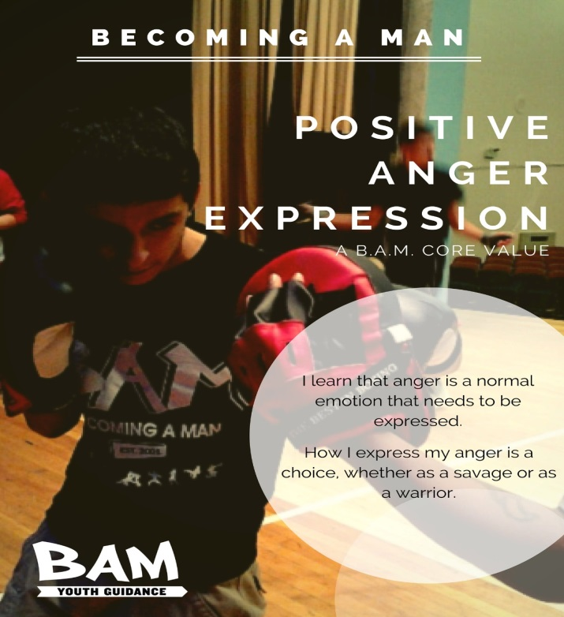


B
E
C
O
M
I
NG
A
M
A
N
CORE
VALUES
Notes:
AJ

Slide 6
Program Impact
Outcome
Measure
Results to Date
Pre/post Development Asset Profile
69% increase in social competency
66% increase in positive values
67% increase in positive identity
60% increase in commitment to learning
of those with low initial scores
Increase social emotional skills
Emotional regulation
Long-term internalization of BAM values that influence decision making
18% Increase in High School Graduation Rate*
88% of B.A.M. participants passed at least ³/₄ of their core classes
96% of B.A.M. participants promoted to next grade
93% of B.A.M. participants reported that they had a positive, supportive relationship with their counselor.
Dropout rates
Grades
Promotion to next grade
Increase school engagement
Reduce destructive behaviors
Violence
Criminal behavior
Arrest data relative to frequency of violence, other arrests, suspensions, etc.
50% Reduction in violent crime arrests*
35% Reduction in any type of arrest*
*New findings of 2013-2015 randomized controlled trial conducted by the University of Chicago Crime Lab (confidential). The researchers estimate the return on investment to be $30 for every $1 invested in B.A.M.
Notes:
AJ

Slide 7
Program Fidelity Monitoring
Youth Guidance has created real-time performance monitoring and evaluation dashboards, which includes:
Student-level attendance/participation records
Group-level progress through the B.A.M. curriculum
Adherence to curriculum elements
Administration of social emotional assessments
Individual counseling
Brief encounter supports and other interactions.
Ongoing analysis of this data allows program leadership to better understand program mechanisms and enable coaches and supervisors to provide high impact technical assistance.
Notes:
AJ

Slide 8
B.A.M. Counselors
B.A.M. Counselor Qualifications:
B.A.M. Training Academy
Core
Competencies
M.S.W. or Master’s in Counseling strongly preferred.
B.A. in related field required
Minimum of two years of group counseling experience
Youth engagement experience
Openness to men’s work
Curriculum training (ongoing, gradual release)
Job shadowing
Mankind Project weekend retreat
E-Learning video modules
Clinical processing
Group development
Modeling
Youth engagement
Systems change leadership
Notes:
Tony D.

Slide 9


Working on Womanhood (W.O.W)
Working on Womanhood (W.O.W.) is a school-based, year long group counseling program that works to improve the social emotional skills and behavior development for 7th-12th grade girls exposed to traumatic stressors and or with emotion regulation difficulties. *
W.O.W. programming is provided through 30 weekly group counseling sessions that occur during the school day.
Based on the principles of cognitive behavioral therapy, W.O.W. creates a safe and supportive space for girls to harness the power of peer support and influence.
Students also visit with their W.O.W. counselor for individual counseling, case management, referrals, or other services.
W.O.W. activities include:
Guided Discussion
Team-building
Field trips
Reflections
Journaling
Group missions

Slide 10
2014-15 Students served
2014-15 W.O.W. students
  75% African American
  21% Latina
  4% White, Asian, Multiracial, or Other ethnicity
96% free or reduced lunch
1,090 students have been served by 26 W.O.W. counselors
110 W.O.W. groups operated at 33 CPS schools
1,787 W.O.W. group sessions held
562 W.O.W. students have also received individual counseling

Slide 11
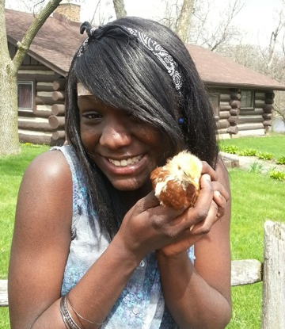
Core Values
W.O.W. serves young women who exhibit a combination of risk factors that include emotional trauma, gang involvement, low GPA, and school suspensions or expulsions. Students are referred to W.O.W. by teachers, school administrators, parents, and clinicians or can volunteer to participate.
The W.O.W. curriculum focuses on five core values:
  Self-awareness
  Emotional intelligence
  Healthy relationships
  Visionary goal-setting
  Leadership
Over one academic year, W.O.W. aims to:
  Reduce absenteeism by fostering school engagement among students
  Reduce behavioral infractions by modeling and instilling constructive ways to express emotion and cope with trauma
  Improve students’ academic achievement by imparting the crucial link between education and future success

Slide 12
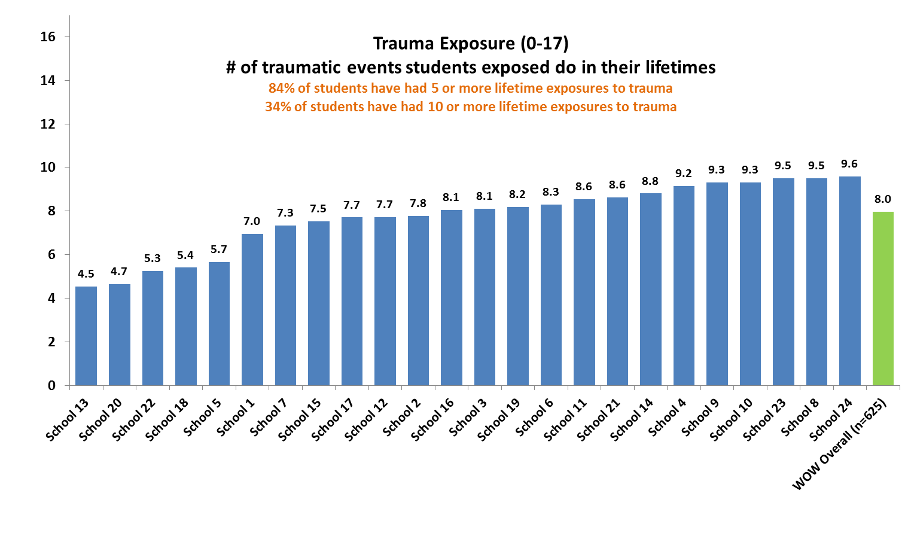
Trauma Exposure
(0-17 scale)

Slide 13
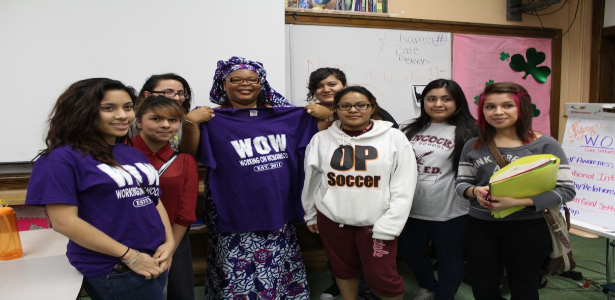
Results
W.O.W. success is defined by outcomes within three main categories:
Social & Emotional Development
Program Engagement & Satisfaction
Academic Engagement & Achievement
W.O.W. outcomes from the 2013-2014 academic year:
86% of participants reported that W.O.W. helped them to identify ways to improve school performance and 93% of participants reported that W.O.W. helped them believe they can graduate.
On average, on a school-by-school basis, W.O.W. students’ attendance rate was 1.6% above the school’s average attendance rate.
93% of W.O.W. participants were promoted to the next grade.
When students apply the values of W.O.W. to their own lives, it results in healthy decision-making, resistance to peer pressure, academic success and more positive relationships with peers, teachers, and family members.
During the 2014-15 academic year, W.O.W. served 1090 young women in 33 schools.

Slide 14
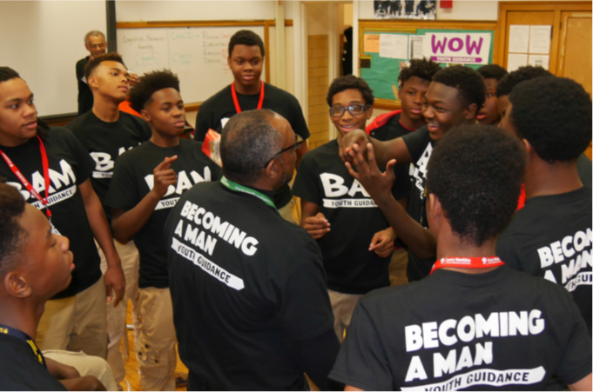
Questions & Answers
To learn more, contact:
Anthony Watson
Director - Becoming A Man
Youth Guidance
1 N LaSalle Street, Suite 900
Chicago, IL 60602
312.994.8101 or
rclarkin@youth-guidance.org

